Slide 1

Chapter 8
Costs Curves

Slide 2
Chapter Eight Overview
Introduction
Long Run Cost Functions
Shifts
Long run average and marginal cost functions
Economies of scale
Deadweight loss – "A Perfectly Competitive Market Without Intervention Maximizes Total Surplus"
Short Run Cost Functions
The Relationship Between Long Run and Short Run Cost Functions
Chapter Eight

Slide 3
Long Run Cost Functions
Definition: The long run total cost function relates minimized total cost to output, Q, and to the factor prices (w and r).
TC(Q,w,r) = wL*(Q,w,r) + rK*(Q,w,r)
Where: L* and K* are the long run input demand functions
Chapter Eight

Slide 4
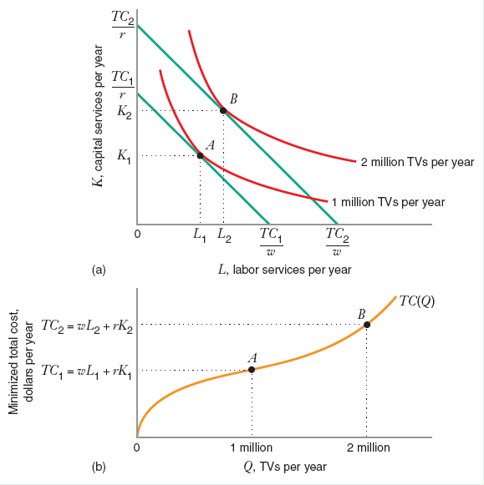
Long Run Cost Functions
As Quantity of output increases from 1 million to 2 million, with input prices(w, r) constant, cost minimizing input combination moves from TC₁ to TC₂ which gives the TC(Q) curve.
Chapter Eight

Slide 5
Long Run Cost Functions
Examples
What is the long run total cost function for production function Q = 50L^{1/2}K^{1/2}?
L*(Q,w,r) = (Q/50)(r/w)^{1/2}
K*(Q,w,r) = (Q/50)(w/r)^{1/2}
TC(Q,w,r) = w[(Q/50)(r/w)^{1/2}]+r[(Q/50)(w/r)^{1/2}]
= (Q/50)(wr)^{1/2} + (Q/50)(wr)^{1/2}
= (Q/25)(wr)^{1/2}
What is the graph of the total cost curve when w = 25 and r = 100?
TC(Q) = 2Q
Chapter Eight

Slide 6
A Total Cost Curve
TC(Q) = 2Q
TC ($ per year)
$4M.
Q (units per year)
Chapter Eight

Slide 7
A Total Cost Curve
TC(Q) = 2Q
TC ($ per year)
$2M.
Q (units per year)
1 M.
Chapter Eight

Slide 8
A Total Cost Curve
TC(Q) = 2Q
TC ($ per year)
$4M.
$2M.
Q (units per year)
1 M.
2 M.
Chapter Eight

Slide 9
Long Run Total Cost Curve
Tracking Movement
Definition: The long run total cost curve shows minimized total cost as output varies, holding input prices constant.
Graphically, what does the total cost curve look like if Q varies and w and r are fixed?
Chapter Eight

Slide 10
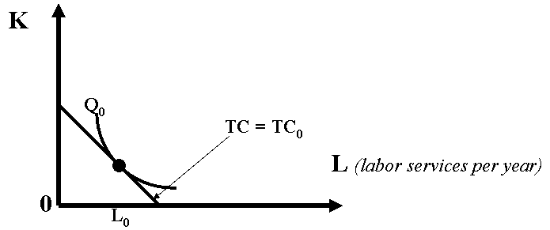
Long Run Total Cost Curve
An Example
Chapter Eight

Slide 11
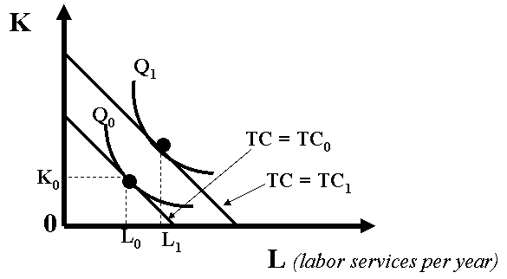
Long Run Total Cost Curve
Chapter Eight

Slide 12
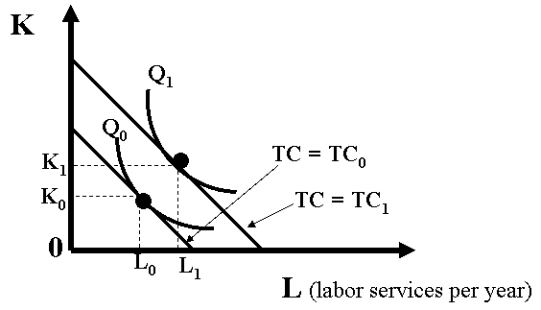
Long Run Total Cost Curve
Chapter Eight

Slide 13
Long Run Total Cost Curve
K
Q₁
Q₀
•
K₁
TC = TC₀
•
K₀
TC = TC₁
0
TC ($/yr)
L₀
L₁
L (labor services per year)
Q (units per year)
0
Chapter Eight

Slide 14
Long Run Total Cost Curve
K
Q₁
Q₀
•
K₁
TC = TC₀
•
K₀
TC = TC₁
TC ($/yr)
0
L₀
L₁
L (labor services per year)
LR Total Cost Curve
TC₀ =wL₀+rK₀
Q (units per year)
0
Q₀
Chapter Eight

Slide 15
Long Run Total Cost Curve
K
Q₁
Q₀
•
K₁
TC = TC₀
TC ($/yr)
•
K₀
TC = TC₁
0
L₀
L₁
L (labor services per year)
TC₁=wL₁+rK₁
LR Total Cost Curve
TC₀ =wL₀+rK₀
0
Q₀
Q₁
Q (units per year)
Chapter Eight

Slide 16
Long Run Total Cost Curve
Identifying Shifts
Graphically, how does the total cost curve shift if wages rise but the price of capital remains fixed?
Chapter Eight

Slide 17
A Change in Input Prices
K
TC₀/r
0
L
Chapter Eight

Slide 18
A Change in Input Prices
K
TC₁/r
TC₀/r
-w₁/r
-w₀/r
0
L
Chapter Eight

Slide 19
A Change in Input Prices
K
TC₁/r
B
•
TC₀/r
A
•
-w₁/r
-w₀/r
0
L
Chapter Eight

Slide 20
A Change in Input Prices
K
TC₁/r
B
TC₀/r
•
A
•
Q₀
-w₁/r
-w₀/r
0
L
Chapter Eight

Slide 21
A Shift in the Total Cost Curve
TC ($/yr)
TC(Q) post
Q (units/yr)
Chapter Eight

Slide 22
A Shift in the Total Cost Curve
TC ($/yr)
TC(Q) post
TC(Q) ante
Q (units/yr)
Chapter Eight

Slide 23
A Shift in the Total Cost Curve
TC ($/yr)
TC(Q) post
TC(Q) ante
TC₀
Q (units/yr)
Chapter Eight

Slide 24
A Shift in the Total Cost Curve
TC ($/yr)
TC(Q) post
TC(Q) ante
TC₁
TC₀
Q₀
Q (units/yr)
Chapter Eight

Slide 25
Input Price Changes
How does the total cost curve shift if all input prices rise (the same amount)?
Chapter Eight

Slide 26
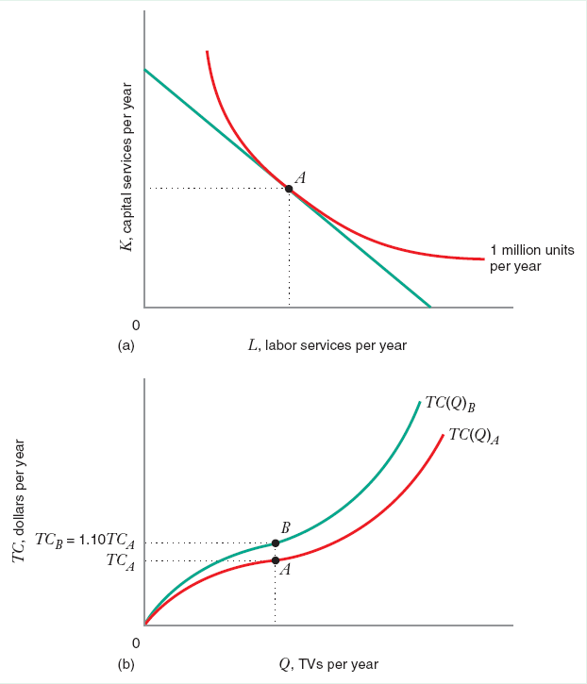
All Input Prices Change equally
Price of input increases proportionately by 10%. Cost minimization input stays same, slope of isoquant is unchanged. TC curve shifts up by the same 10 percent
Chapter Eight

Slide 27
Long Run Average Cost Function
Definition: The long run average cost function is the long run total cost function divided by output, Q.
That is, the LRAC function tells us the firm’s cost per unit of output…
AC(Q,w,r) = TC(Q,w,r)/Q
Chapter Eight

Slide 28
Long Run Marginal Cost Function
Definition: The long run marginal cost function measures the rate of change of total cost as output varies, holding constant input prices.
MC(Q,w,r) =
{TC(Q+ΔQ,w,r) – TC(Q,w,r)}/ΔQ
= ΔTC(Q,w,r)/ΔQ
where: w and r are constant
Chapter Eight

Slide 29
Long Run Marginal Cost Function
Example
Recall that, for the production function Q = 50L^{1/2}K^{1/2}, the total cost function was TC(Q,w,r) = (Q/25)(wr)^{1/2}. If w = 25, and r = 100, TC(Q) = 2Q.
Chapter Eight

Slide 30
Long Run Marginal Cost Function
a. What are the long run average and marginal cost functions for this production function?
AC(Q,w,r) = (wr)^{1/2}/25
MC(Q,w,r) = (wr)^{1/2}/25
b. What are the long run average and marginal cost curves when w = 25 and r = 100?
AC(Q) = 2Q/Q = 2.
MC(Q) = Δ(2Q)/ΔQ = 2.
Chapter Eight

Slide 31
Average & Marginal Cost Curves
AC, MC ($ per unit)
$2
AC(Q) =
MC(Q) = 2
Q (units/yr)
0
Chapter Eight

Slide 32
Average & Marginal Cost Curves
AC, MC ($ per unit)
$2
AC(Q) =
MC(Q) = 2
Q (units/yr)
0
1M
Chapter Eight

Slide 33
Average & Marginal Cost Curves
AC, MC ($ per unit)
$2
AC(Q) =
MC(Q) = 2
Q (units/yr)
0
1M 2M
Chapter Eight

Slide 34
Average & Marginal Cost Curves
What is Their Relationship?
Suppose that w and r are fixed:
When marginal cost is less than average cost, average cost is decreasing in quantity. That is, if MC(Q) < AC(Q), AC(Q) decreases in Q.
Chapter Eight

Slide 35
Average & Marginal Cost Curves
What is Their Relationship?
When marginal cost is greater than average cost, average cost is increasing in quantity. That is, if MC(Q) > AC(Q), AC(Q) increases in Q.
When marginal cost equals average cost, average cost does not change with quantity. That is, if MC(Q) = AC(Q), AC(Q) is flat with respect to Q.
Chapter Eight

Slide 36
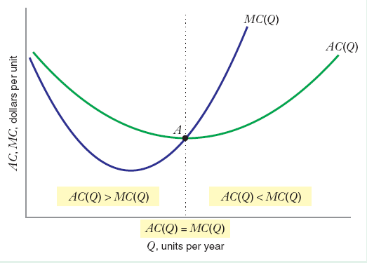
Average & Marginal Cost Curves
Chapter Eight

Slide 37
Economies & Diseconomies of Scale
Definition: If average cost decreases as output rises, all else equal, the cost function exhibits economies of scale.
Similarly, if the average cost increases as output rises, all else equal, the cost function exhibits diseconomies of scale.
Definition: The smallest quantity at which the long run average cost curve attains its minimum point is called the minimum efficient scale.
Chapter Eight

Slide 38
Minimum Efficiency Scale (MES)
AC ($/yr)
AC(Q)
Q (units/yr)
0
Q* = MES
Chapter Eight

Slide 39
Returns to Scale & Economies of Scale
When the production function exhibits increasing returns to scale, the long run average cost function exhibits economies of scale so that AC(Q) decreases with Q, all else equal.
Chapter Eight

Slide 40
Returns to Scale & Economies of Scale
When the production function exhibits decreasing returns to scale, the long run average cost function exhibits diseconomies of scale so that AC(Q) increases with Q, all else equal.
When the production function exhibits constant returns to scale, the long run average cost function is flat: it neither increases nor decreases with output.
Chapter Eight

Slide 41
Output Elasticity of Total Cost
Definition: The percentage change in total cost per one percent change in output is the output elasticity of total cost, ε_{TC,Q}.
ε_{TC,Q} = (ΔTC/TC)(ΔQ /Q)
= (ΔTC/ΔQ)/(TC/Q) = MC/AC
If ε_{TC,Q} < 1, MC < AC, so AC must be decreasing in Q. Therefore, we have economies of scale.
If ε_{TC,Q} > 1, MC > AC, so AC must be increasing in Q. Therefore, we have diseconomies of scale.
If ε_{TC,Q} = 1, MC = AC, so AC is just flat with respect to Q.
Chapter Eight

Slide 42
Short Run & Total Variable Cost Functions
Definition: The short run total cost function tells us the minimized total cost of producing Q units of output, when (at least) one input is fixed at a particular level.
Definition: The total variable cost function is the minimized sum of expenditures on variable inputs at the short run cost minimizing input combinations.
Chapter Eight

Slide 43
Total Fixed Cost Function
Definition: The total fixed cost function is a constant equal to the cost of the fixed input(s).
STC(Q,K₀) = TVC(Q,K₀) + TFC(Q,K₀)
Where: K₀ is the fixed input and w and r are fixed (and suppressed as arguments)
Chapter Eight

Slide 44
Key Cost Functions Interactions
TC ($/yr)
Example: Short Run Total Cost, Total Variable Cost and Total Fixed Cost
TFC
Q (units/yr)
Chapter Eight

Slide 45
Key Cost Functions Interactions
TC ($/yr)
Example: Short Run Total Cost, Total Variable Cost and Total Fixed Cost
TVC(Q, K₀)
TFC
Q (units/yr)
Chapter Eight

Slide 46
Key Cost Functions Interactions
TC ($/yr)
Example: Short Run Total Cost, Total Variable Cost and Total Fixed Cost
STC(Q, K₀)
TVC(Q, K₀)
TFC
Q (units/yr)
Chapter Eight

Slide 47
Key Cost Functions Interactions
TC ($/yr)
Example: Short Run Total Cost, Total Variable Cost and Total Fixed Cost
STC(Q, K₀)
rK₀
TVC(Q, K₀)
TFC
rK₀
Q (units/yr)
Chapter Eight

Slide 48
Long and Short Run Total Cost Functions
Understanding the Relationship
The firm can minimize costs at least as well in the long run as in the short run because it is “less constrained”.
Hence, the short run total cost curve lies everywhere above the long run total cost curve.
Chapter Eight

Slide 49
Long and Short Run Total Cost Functions
Understanding the Relationship
However, when the quantity is such that the amount of the fixed inputs just equals the optimal long run quantities of the inputs, the short run total cost curve and the long run total cost curve coincide.
Chapter Eight

Slide 50
Long and Short Run Total Cost Functions
K
TC₀/r
0
L
TC₀/w
Chapter Eight

Slide 51
Long and Short Run Total Cost Functions
K
TC₁/r
TC₀/r
•
B
K⁰
0
L
TC₀/w TC₁/w
Chapter Eight

Slide 52
Long and Short Run Total Cost Functions
K
TC₂/r
Q₁
TC₁/r
TC₀/r
•
C
•
A
•
K⁰
B
0
L
TC₀/w TC₁/w TC₂/w
Chapter Eight

Slide 53
Long and Short Run Total Cost Functions
K
TC₂/r
Q₁
TC₁/r
Expansion Path
TC₀/r
•
C
Q₀
Q₀
•
A
•
K⁰
B
0
L
TC₀/w TC₁/w TC₂/w
Chapter Eight

Slide 54
Long and Short Run Total Cost Functions
Total Cost ($/yr)
STC(Q,K₀)
TC(Q)
K₀ is the LR cost-minimising
quantity of K for Q₀
0
Q₀
Q₁
Q (units/yr)
Chapter Eight

Slide 55
Long and Short Run Total Cost Functions
Total Cost ($/yr)
STC(Q,K₀)
TC(Q)
A
•
TC₀
K₀ is the LR cost-minimising
quantity of K for Q₀
0
Q₀
Q₁
Q (units/yr)
Chapter Eight

Slide 56
Long and Short Run Total Cost Functions
Total Cost ($/yr)
STC(Q,K₀)
TC(Q)
•
TC₁
C
A
•
TC₀
K₀ is the LR cost-minimising
quantity of K for Q₀
0
Q₀
Q₁
Q (units/yr)
Chapter Eight

Slide 57
Long and Short Run Total Cost Functions
Total Cost ($/yr)
STC(Q,K₀)
•
TC(Q)
TC₂
B
•
TC₁
C
A
•
TC₀
K₀ is the LR cost-minimising
quantity of K for Q₀
0
Q₀
Q₁
Q (units/yr)
Chapter Eight

Slide 58
Short Run Average Cost Function
Definition: The Short run average cost function is the short run total cost function divided by output, Q.
That is, the SAC function tells us the firm’s short run cost per unit of output.
SAC(Q,K₀) = STC(Q,K₀)/Q
Where: w and r are held fixed
Chapter Eight

Slide 59
Short Run Marginal Cost Function
Definition: The short run marginal cost function measures the rate of change of short run total cost as output varies, holding constant input prices and fixed inputs.
SMC(Q,K₀)={STC(Q+ΔQ,K₀)–STC(Q,K₀)}/ΔQ
= ΔSTC(Q,K₀)/ΔQ
where: w,r, and K₀ are constant
Chapter Eight

Slide 60
Summary Cost Functions
Note: When STC = TC, SMC = MC
STC = TVC + TFC
SAC = AVC + AFC
Where:
SAC = STC/Q
AVC = TVC/Q (“average variable cost”)
AFC = TFC/Q (“average fixed cost”)
The SAC function is the VERTICAL sum of the AVC and AFC functions
Chapter Eight

Slide 61
Summary Cost Functions
$ Per Unit
Example: Short Run Average Cost, Average Variable Cost and Average Fixed Cost
AFC
0
Q (units per year)
Chapter Eight

Slide 62
Summary Cost Functions
$ Per Unit
AVC
Example: Short Run Average Cost, Average Variable Cost and Average Fixed Cost
AFC
0
Q (units per year)
Chapter Eight

Slide 63
Summary Cost Functions
SAC
$ Per Unit
AVC
Example: Short Run Average Cost, Average Variable Cost and Average Fixed Cost
AFC
0
Q (units per year)
Chapter Eight

Slide 64
Summary Cost Functions
SAC
$ Per Unit
SMC
AVC
Example: Short Run Average Cost, Average Variable Cost and Average Fixed Cost
AFC
0
Q (units per year)
Chapter Eight

Slide 65
Long Run Average Cost Function
As an Envelope Curve
$ per unit
SAC(Q,K₃)
AC(Q)
•
•
•
0
Q₁ Q₂ Q₃
Q (units per year)
Chapter Eight

Slide 66
Long Run Average Cost Function
As an Envelope Curve
$ per unit
SAC(Q,K₁)
AC(Q)
•
•
•
0
Q₁ Q₂ Q₃
Q (units per year)
Chapter Eight

Slide 67
Long Run Average Cost Function
As an Envelope Curve
$ per unit
SAC(Q,K₁)
SAC(Q,K₂)
AC(Q)
•
•
•
0
Q₁ Q₂ Q₃
Q (units per year)
Chapter Eight

Slide 68
Long Run Average Cost Function
As an Envelope Curve
$ per unit
SAC(Q,K₃)
SAC(Q,K₁)
SAC(Q,K₂)
AC(Q)
•
•
•
0
Q₁ Q₂ Q₃
Q (units per year)
Chapter Eight

Slide 69
Long Run Average Cost Function
As an Envelope Curve
Example: Let Q = K^{1/2}L^{1/4}M^{1/4} and let
w = 16, m = 1 and r = 2. For this production function and these input prices, the long run input demand curves are:
L*(Q) = Q/8
M*(Q) = 2Q
K*(Q) = 2Q
Therefore, the long run total cost curve is:
TC(Q) = 16(Q/8) + 1(2Q) + 2(2Q) = 8Q
The long run average cost curve is:
AC(Q) = TC(Q)/Q = 8Q/Q = 8
Chapter Eight

Slide 70
Short Run Average Cost Function
Recall, too, that the short run total cost curve for fixed level of capital K₀ is:
STC(Q,K₀) = (8Q²)/K₀ + 2K₀
If the level of capital is fixed at K₀ what is the short run average cost curve?
SAC(Q,K₀) = 8Q/K₀ + 2K₀/Q
Chapter Eight

Slide 71
Cost Function Summary
$ per unit
MC(Q)
Q (units per year)
0
Chapter Eight

Slide 72
Cost Function Summary
$ per unit
MC(Q)
AC(Q)
Q (units per year)
0
Chapter Eight

Slide 73
Cost Function Summary
$ per unit
MC(Q)
SAC(Q,K₂)
AC(Q)
•
•
SMC(Q,K₁)
Q (units per year)
0
Q₁ Q₂ Q₃
Chapter Eight

Slide 74
Cost Function Summary
MC(Q)
$ per unit
MC(Q)
SAC(Q,K₃)
SAC(Q,K₁)
SAC(Q,K₂)
AC(Q)
•
•
•
SMC(Q,K₁)
Q (units per year)
0
Q₁ Q₂ Q₃
Chapter Eight

Slide 75
Cost Function Summary
MC(Q)
$ per unit
MC(Q)
SAC(Q,K₃)
SAC(Q,K₁)
SAC(Q,K₂)
AC(Q)
•
•
•
SMC(Q,K₁)
Q (units per year)
0
Q₁ Q₂ Q₃
Chapter Eight

Slide 76
Economies of Scope
Economies of Scope – a production characteristic in which the total cost of producing given quantities of two goods in the same firm is less than the total cost of producing those quantities in two single-product firms.
Mathematically,
TC(Q₁, Q₂) < TC(Q₁, 0) + TC(0, Q₂)
Stand-alone Costs – the cost of producing a good in a single-product firm, represented by each term in the right-hand side of the above equation.
Chapter Eight

Slide 77
Economies of Experience
Economies of Experience – cost advantages that result from accumulated experience, or, learning-by-doing.
Experience Curve – a relationship between average variable cost and cumulative production volume
– used to describe economies of experience
– typical relationship is AVC(N) = AN^{B},
where N – cumulative production volume,
A > 0 – constant representing AVC of first unit produced,
-1 < B < 0 – experience elasticity (% change in AVC for
every 1% increase in cumulative volume
– slope of the experience curve tells us how much AVC
goes down (as a % of initial level), when cumulative
output doubles
Chapter Eight

Slide 78
Estimating Cost Functions
Total Cost Function – a mathematical relationship that shows how total costs vary with factors that influence total costs, including the quantity of output and prices of inputs.
Cost Driver – A factor that influences or “drives” total or average costs.
Constant Elasticity Cost Function – A cost function that specifies constant elasticity of total cost with respect to output and input prices.
Translog Cost Function – A cost function that postulates a quadratic relationship between the log of total cost and the logs of input prices and output.
Chapter Eight

